Slide 1
Classes & Objects
Runming Li

Slide 2
Content
Constructor
Default constructor
CONSTRUCTORS
ACCESSORS
MUTATORS
Type of methods
References
PASSING PRIMITIVE TYPES AS PARAMETERS
PASSING OBJECTS AS PARAMETERS

Slide 3
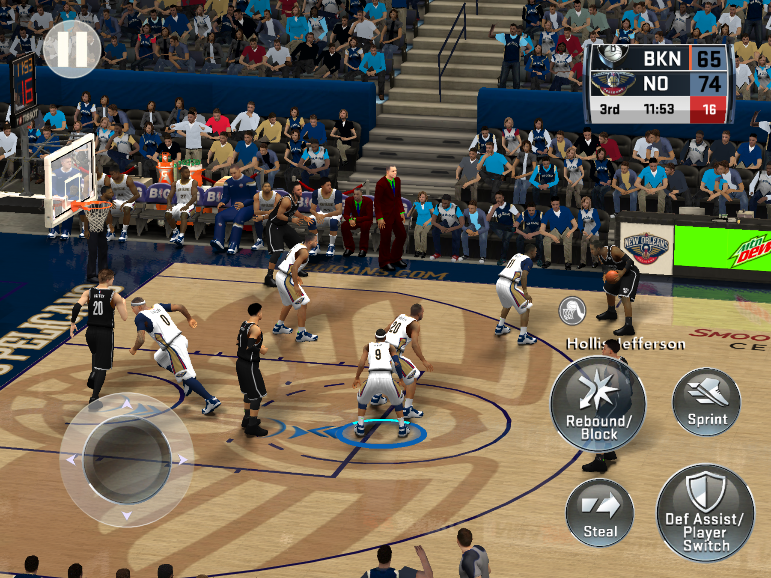
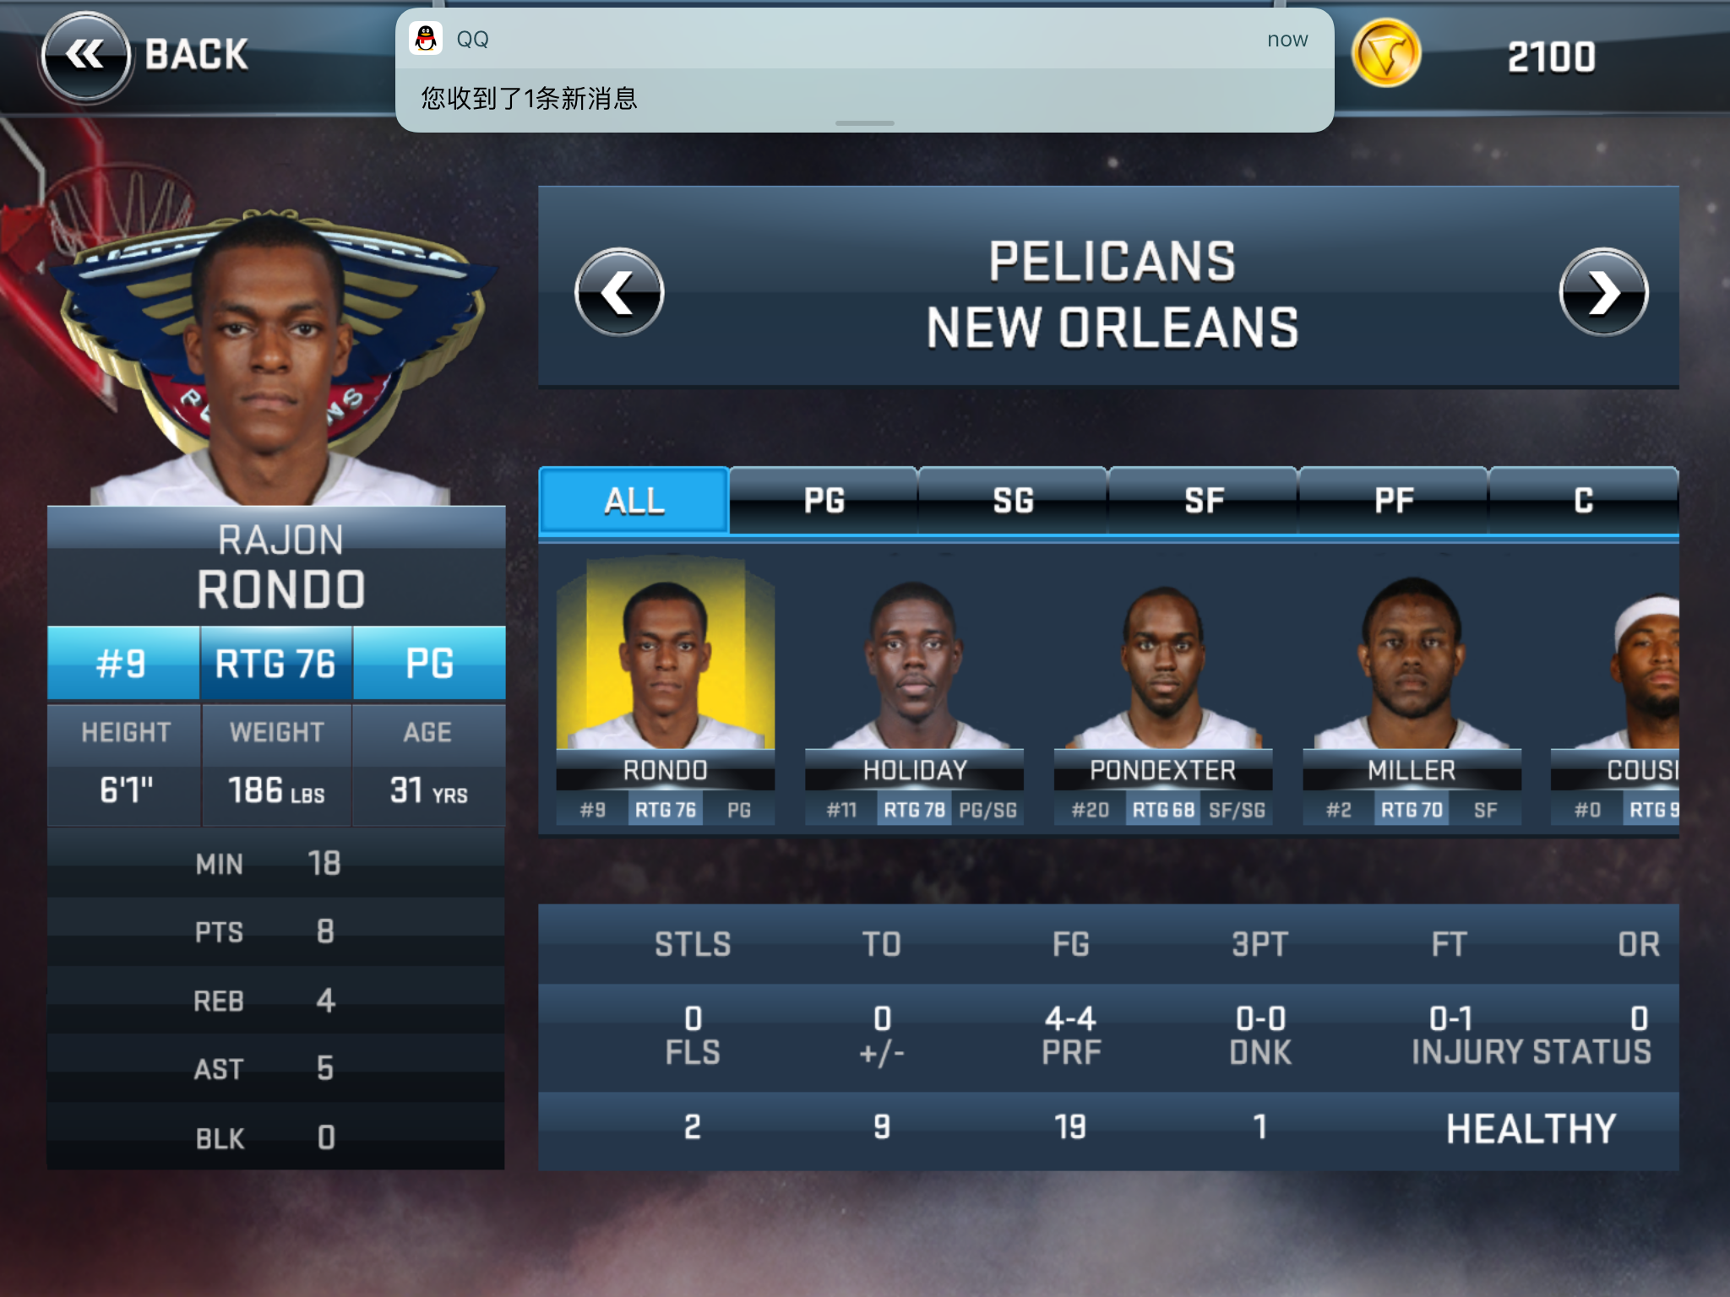
Object
State and behavior

Slide 4
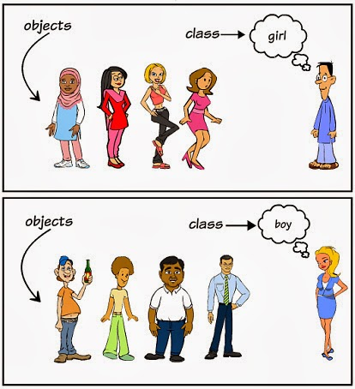
Class
Player1
Player2
Player3
Player4
Player5
.
.
.
.
Player Class

Slide 5
Modifier
Class modifier
public abstract final friendly
Member variable modifier
public private protected friendly final static transient volatile
Method modifier
public private protected final static synchronize native

Slide 6
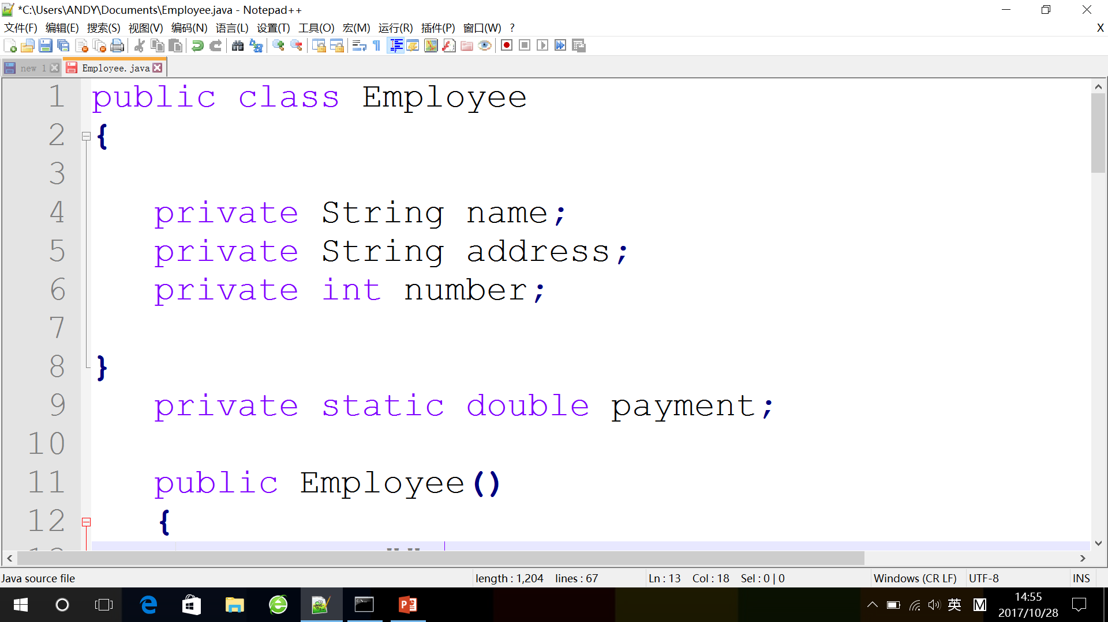
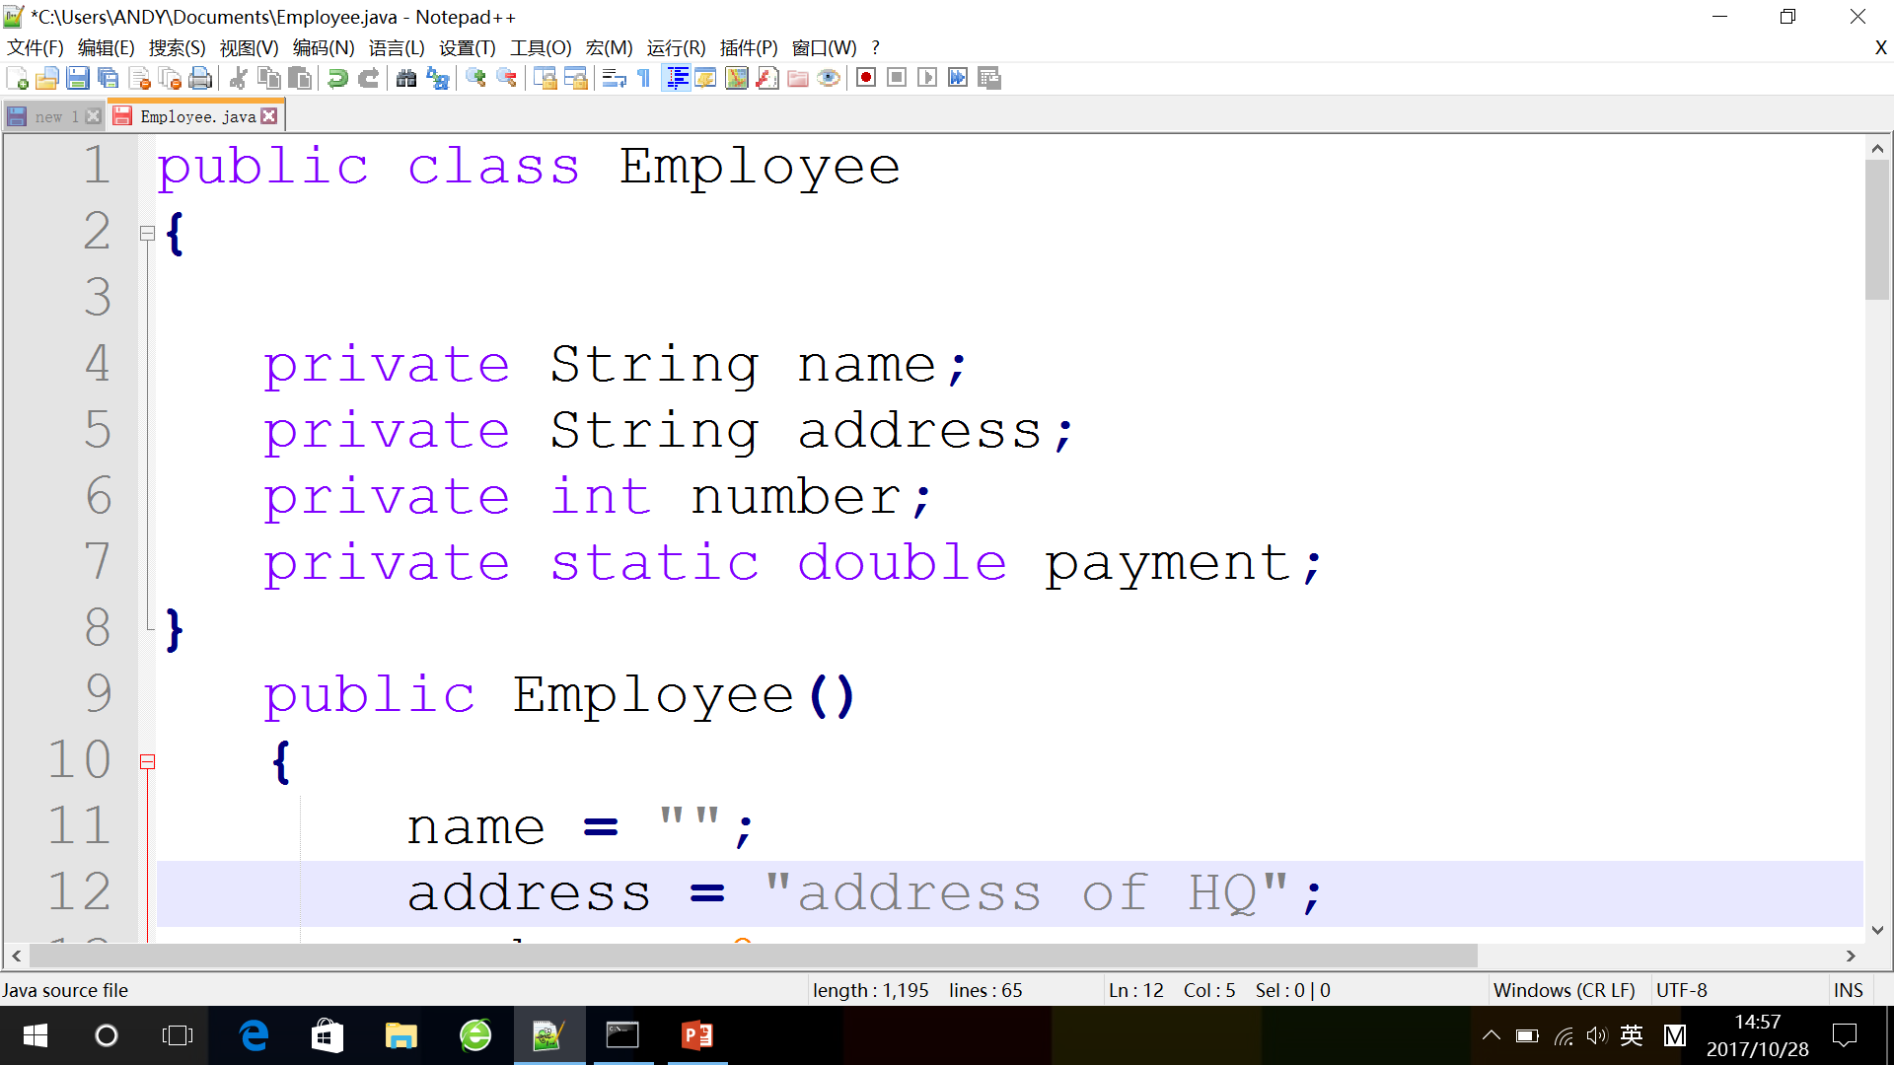
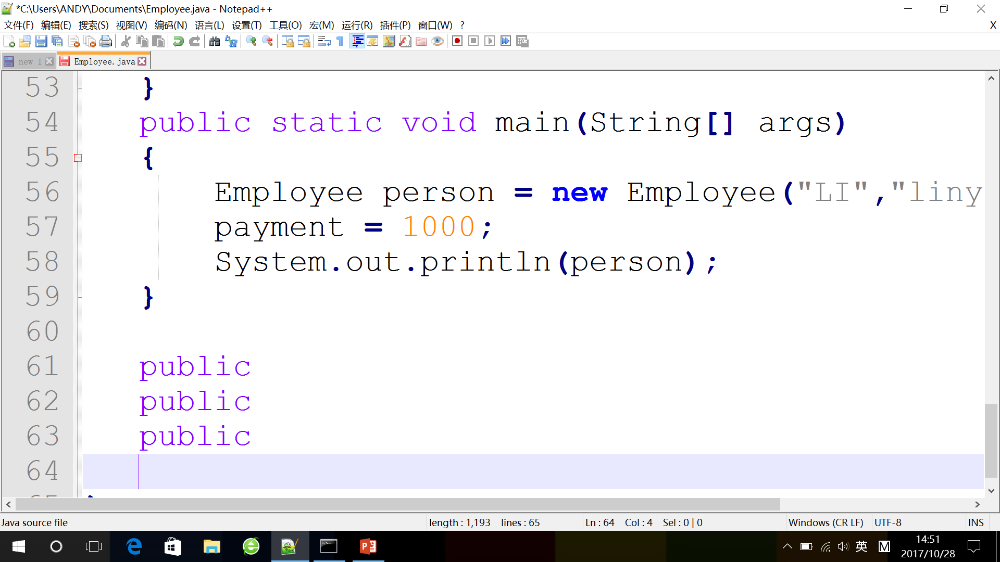
Variable
Question1
Question2

Slide 7
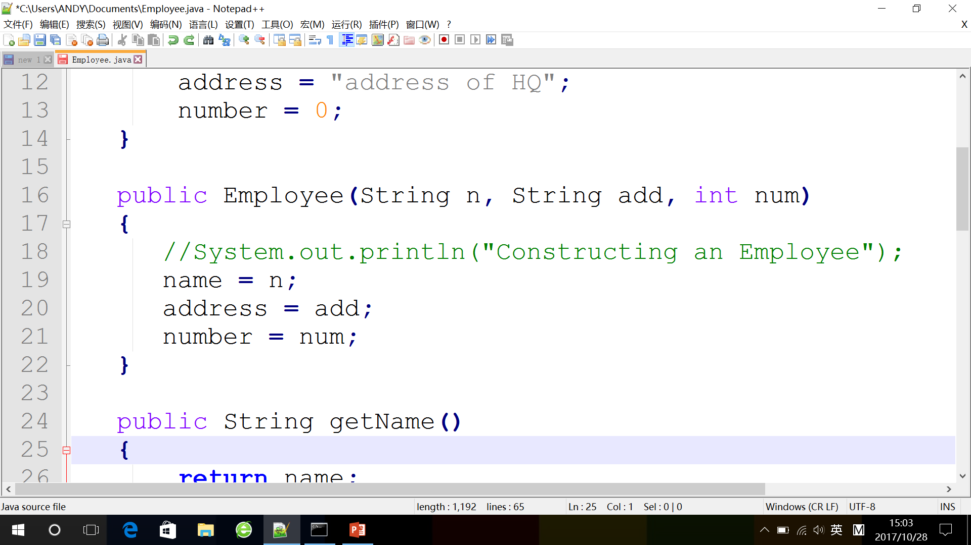
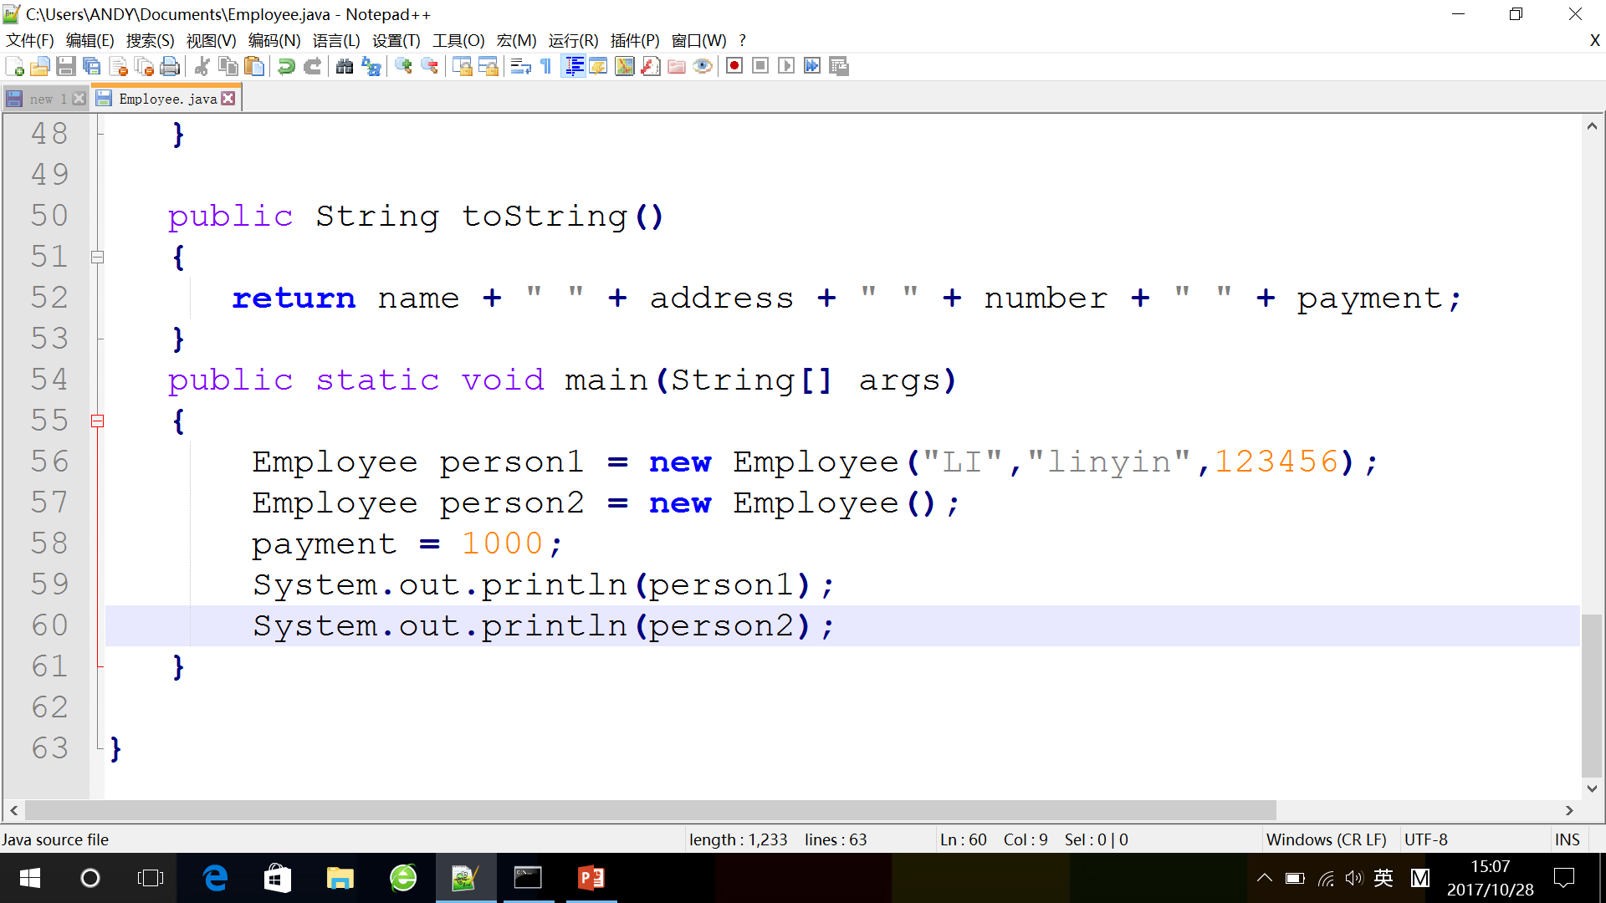
Constructor
Question

Slide 8
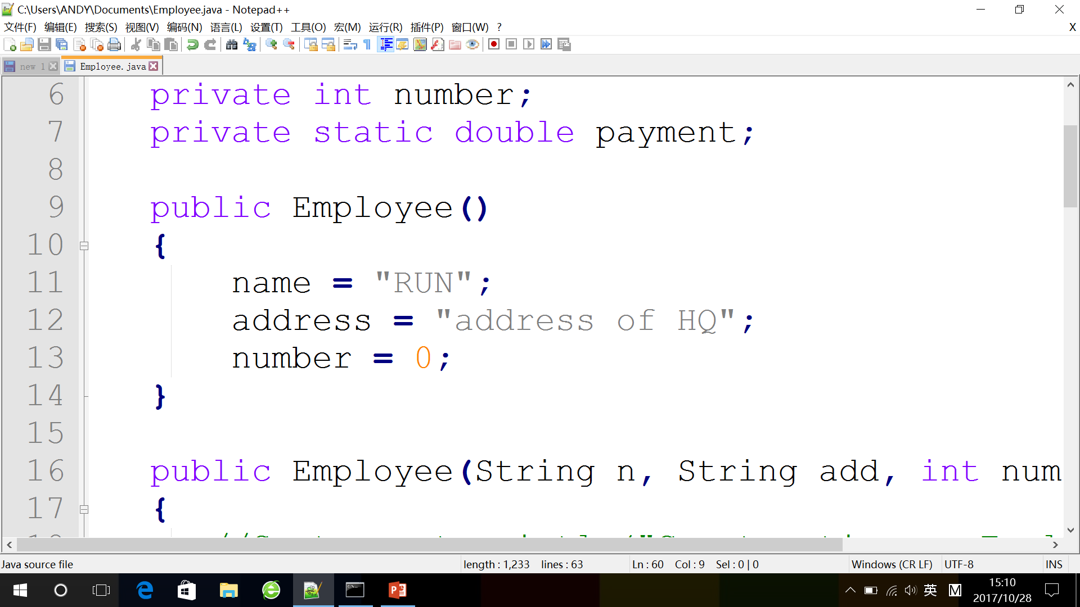
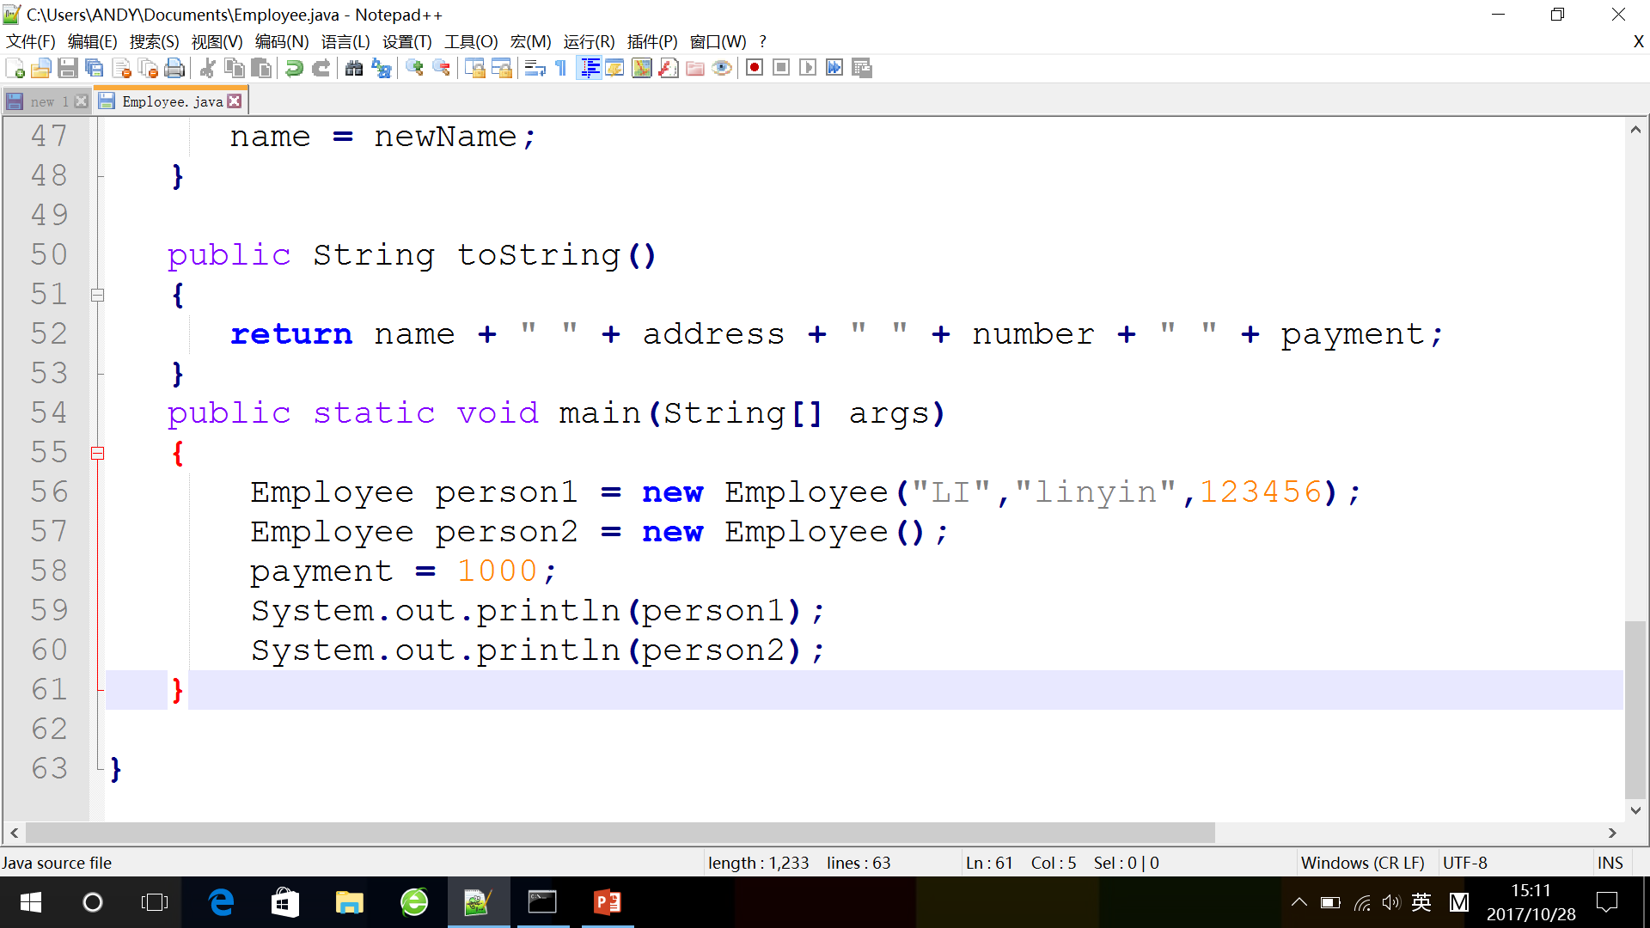
Default constructor
Question

Slide 9
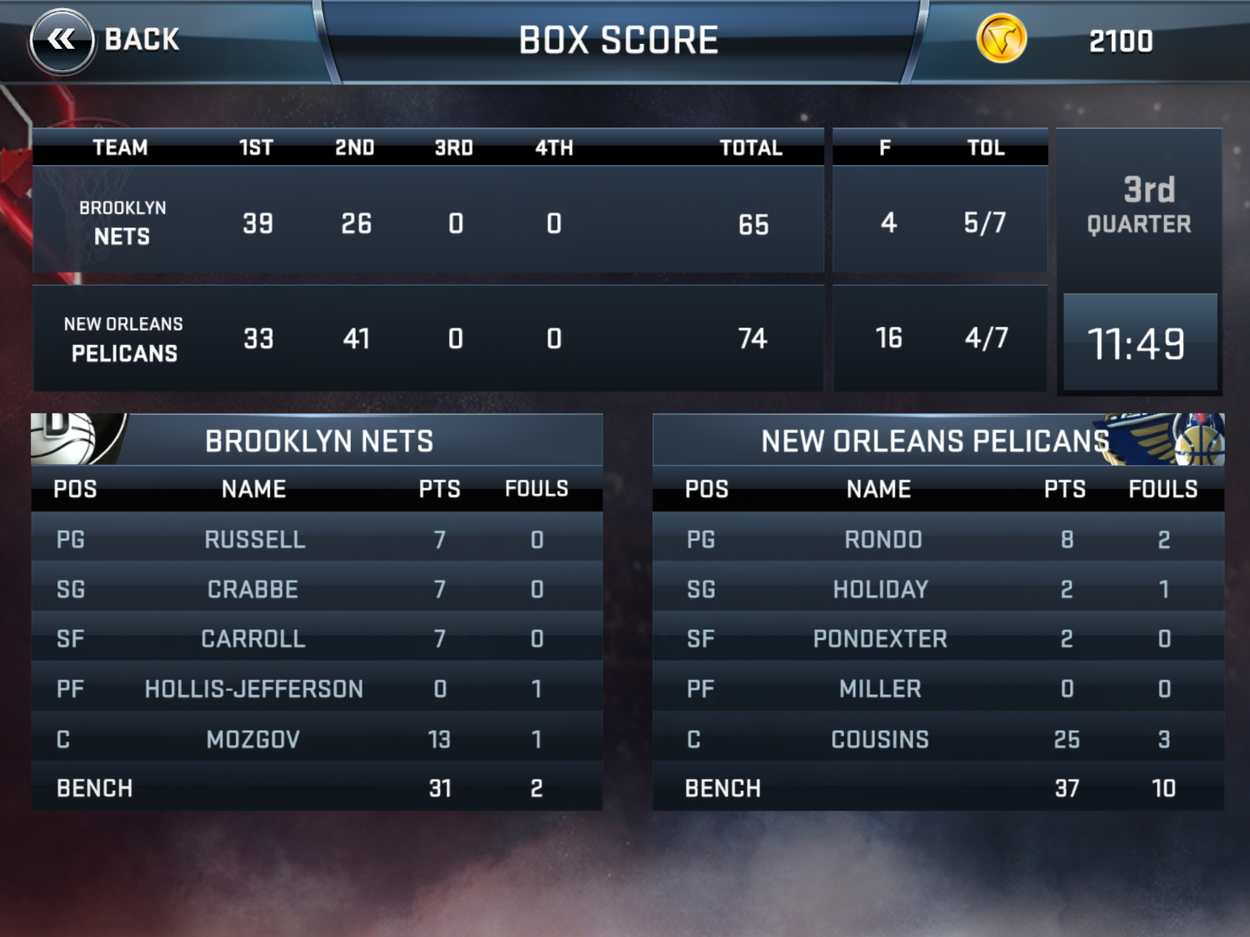
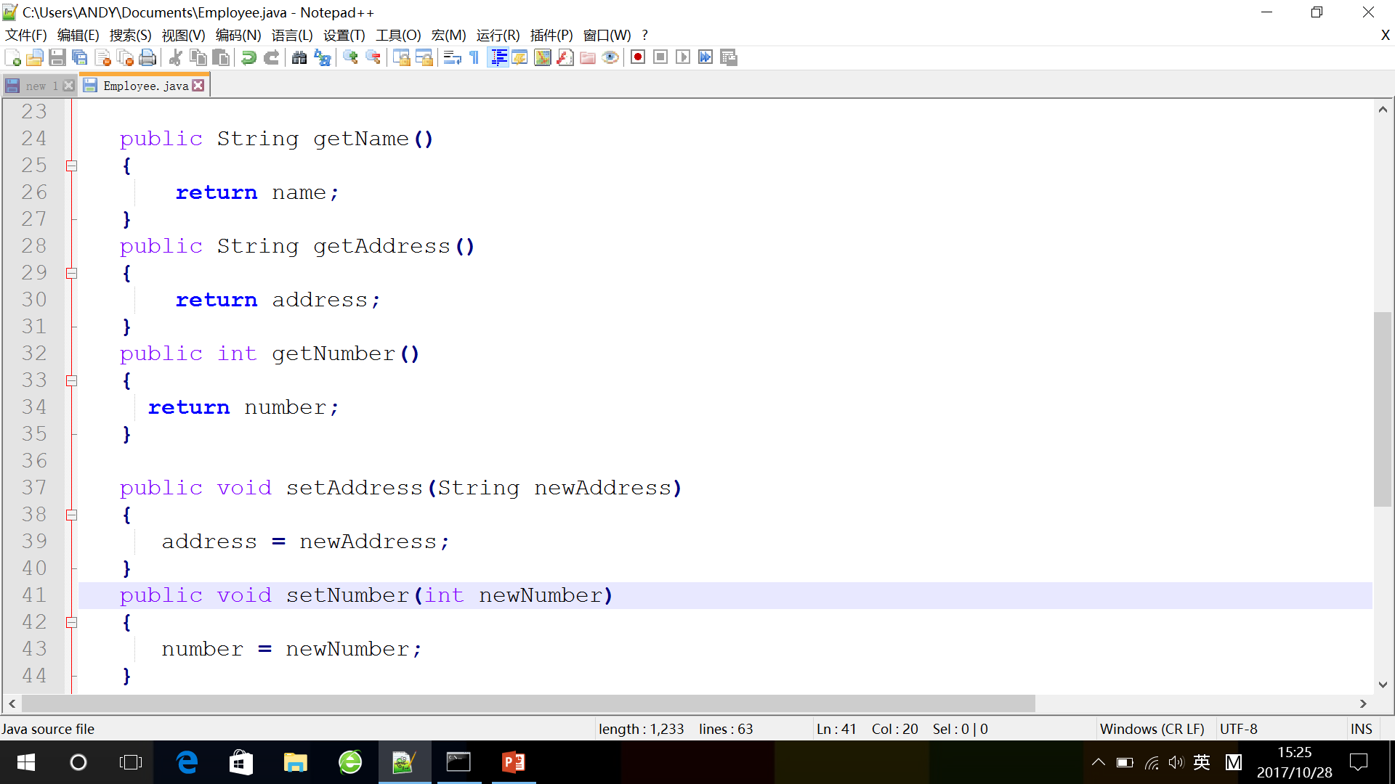
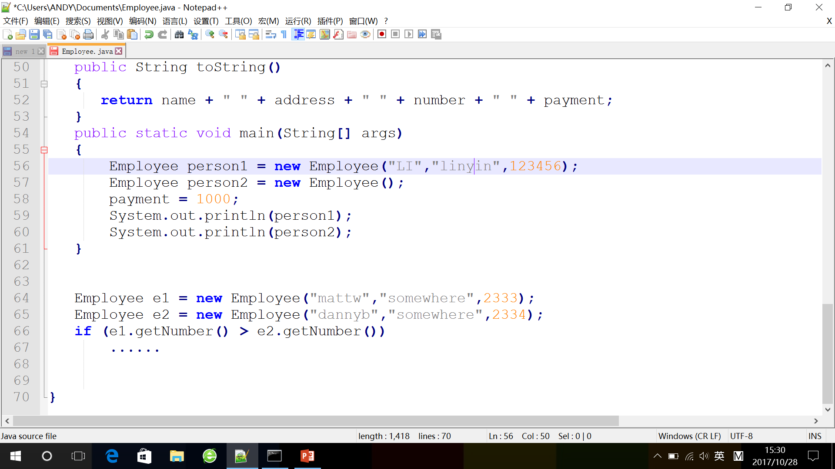
Accessor
Question

Slide 10
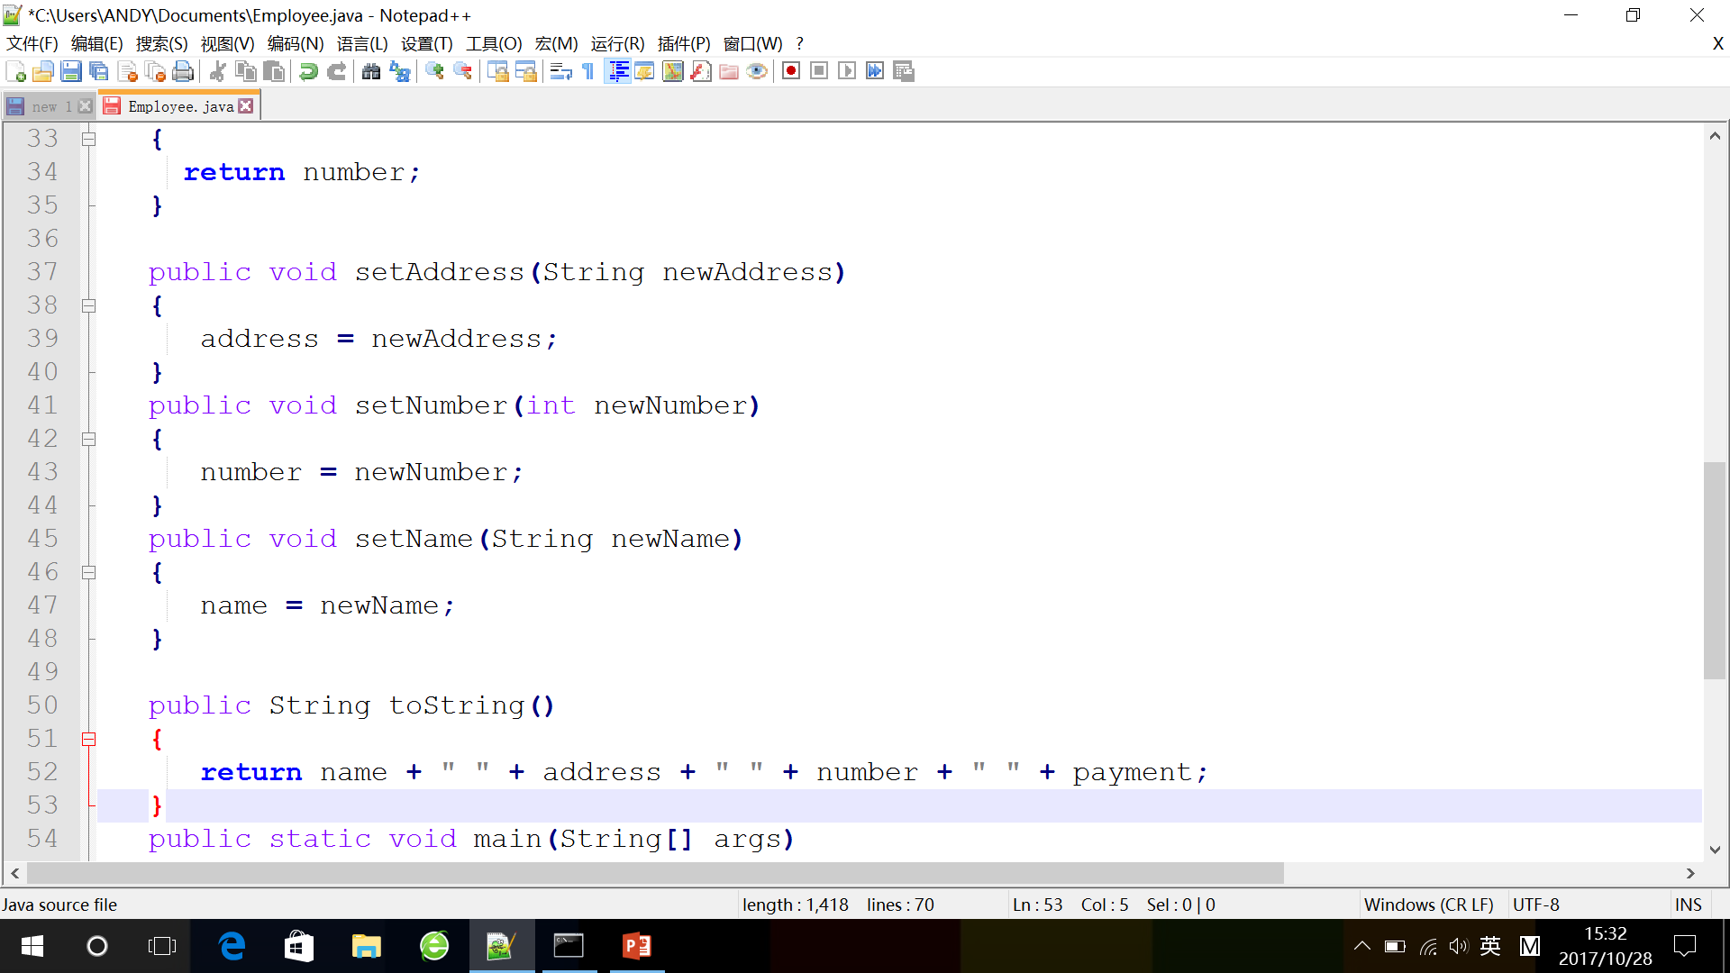
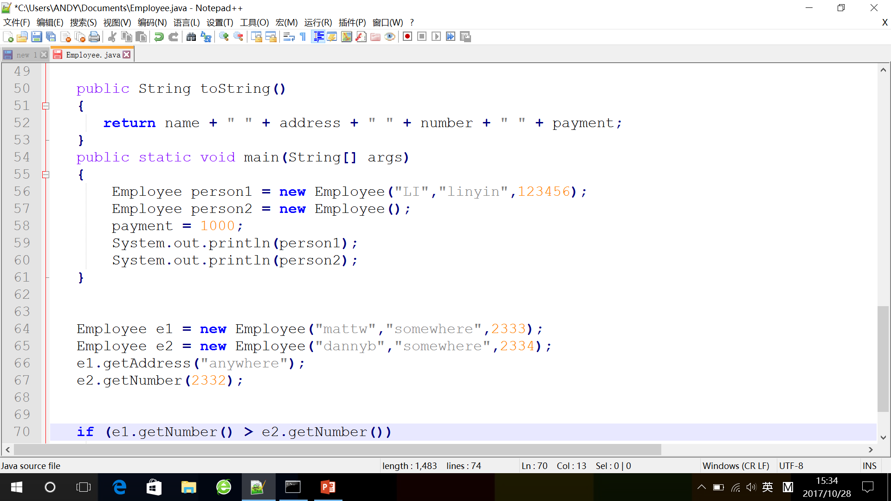
Mutator
Question

Slide 11
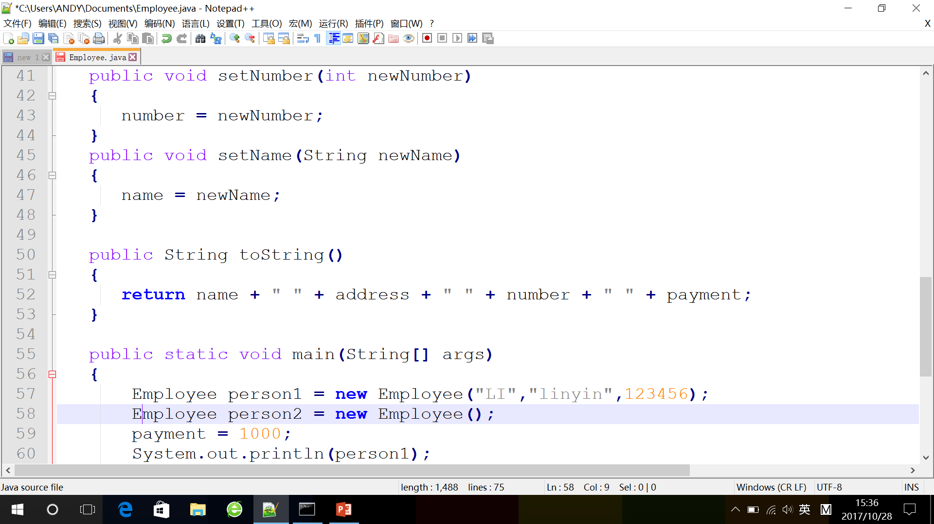
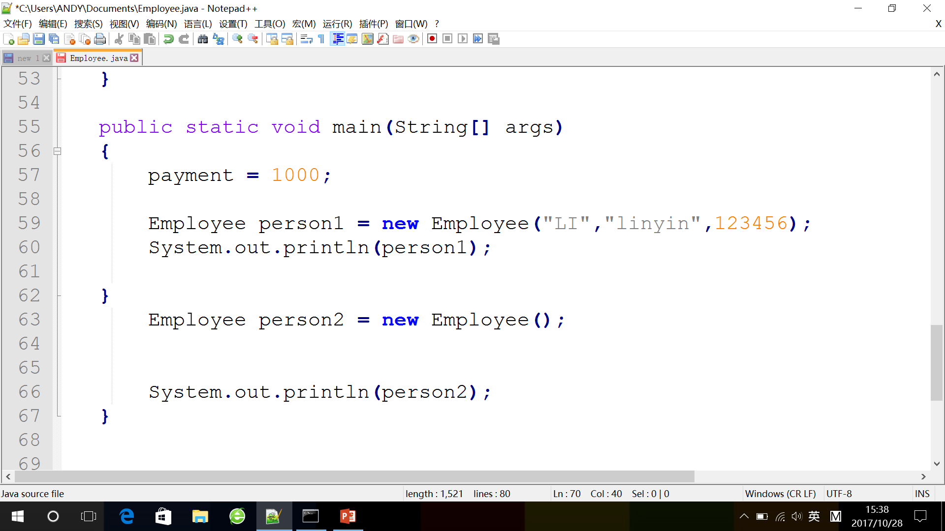
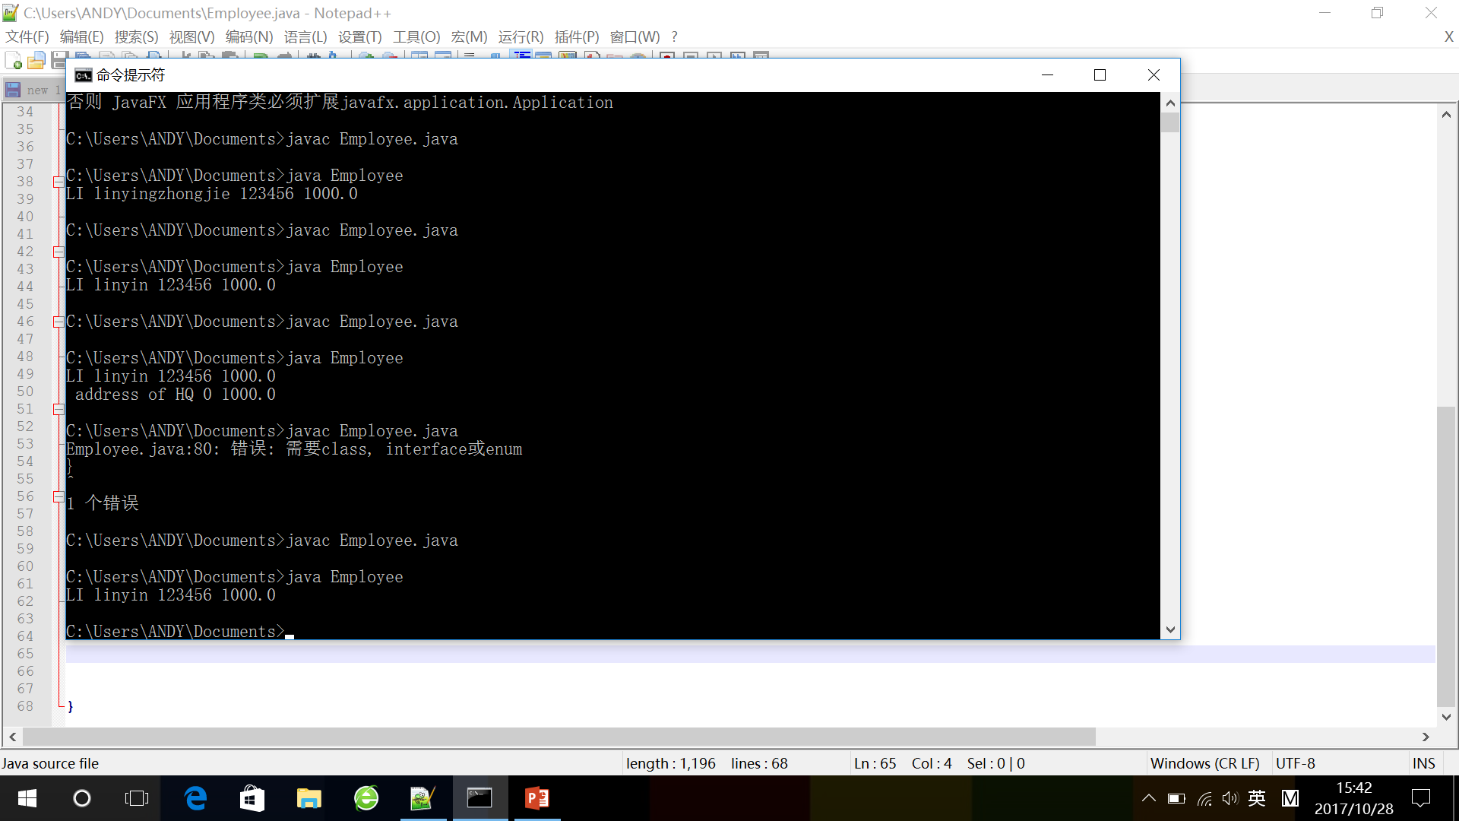
toString
Question

Slide 12
Practice BankAccount
Variable : password, balance
Constructor : default constructor, constructor
Accessor : getBalance
Mutator : deposit, withdraw

Slide 13
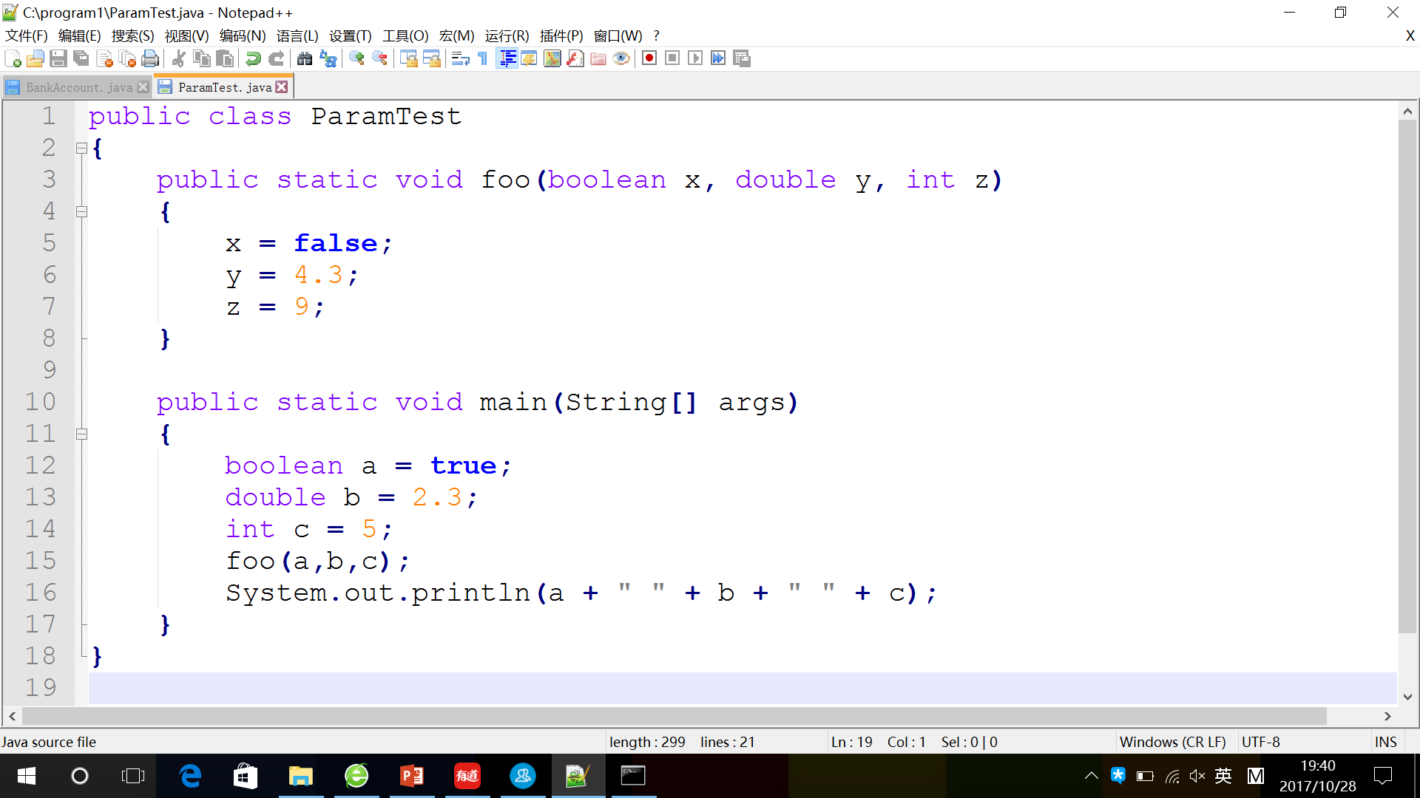
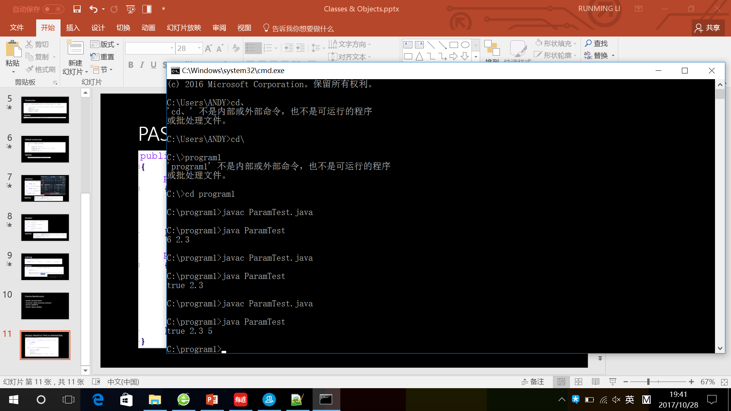
PASSING PRIMITIVE TYPES AS PARAMETERS

Slide 14
Just before the foo(a,b,c) method call:
At the time of the foo(a,b,c) method call:
a b c
a b c
true 2.3 5
true 2.3 5
x y z
true 2.3 5
Just before exiting the method:
After exiting the method:
a b c
a b c
true 2.3 5
true 2.3 5
x y z
false 4.3 9

Slide 15
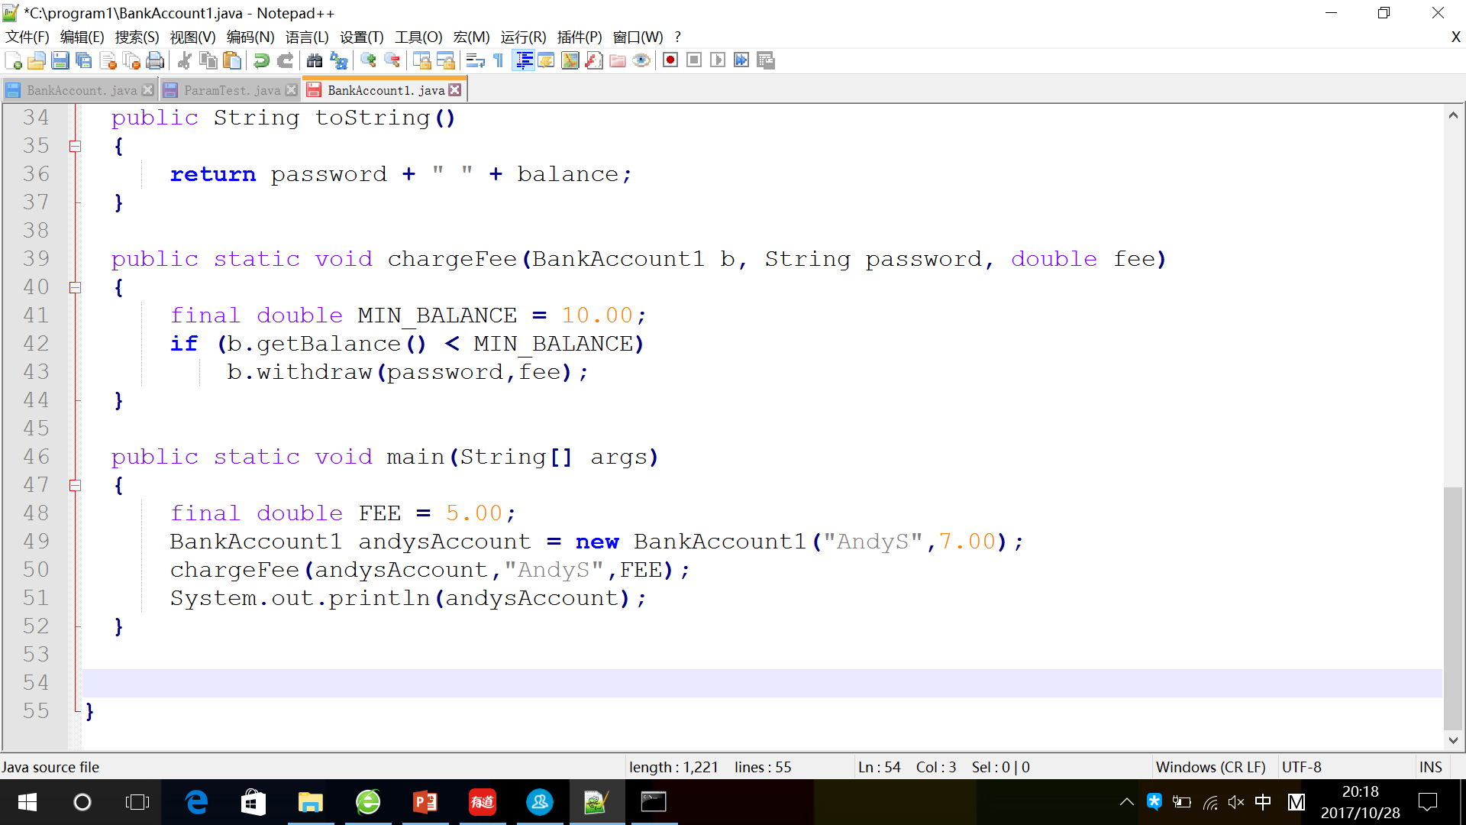
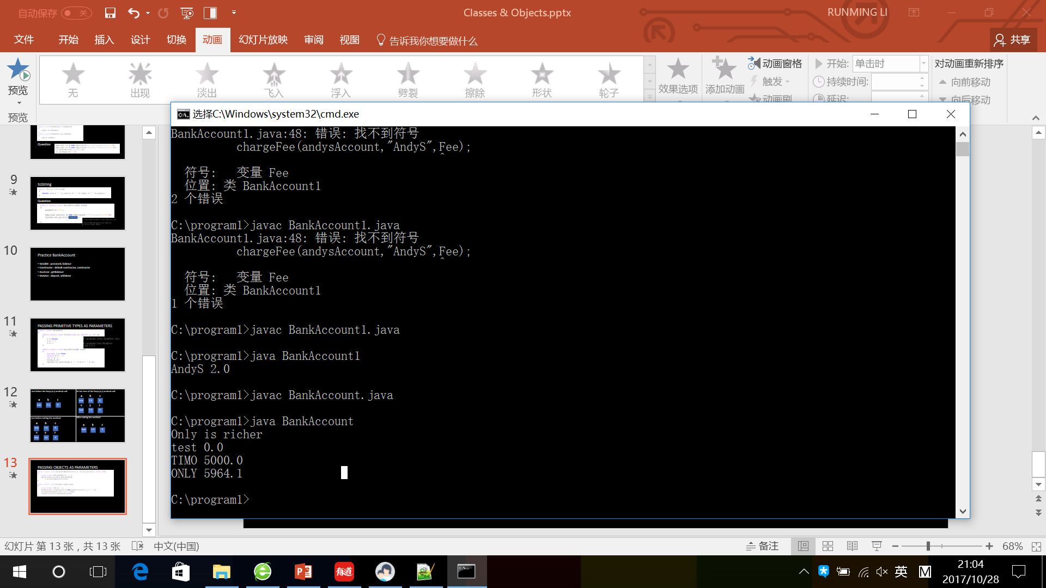
PASSING OBJECTS AS PARAMETERS

Slide 16
Before the chargeFee method call:
FEE andysAccount
BankAccount
5
password
“AndyS””
balance
7

Slide 17
At the time of the chargeFee method call:
FEE andysAccount
BankAccount
5
password
“AndyS””
fee b
balance
7
5
password
“AndyS”

Slide 18
Just before exiting the method:
FEE andysAccount
BankAccount
5
password
“AndyS””
fee b
balance
2
5
password
“AndyS”

Slide 19
After exiting the method:
FEE andysAccount
BankAccount
5
password
“AndyS””
balance
2

Slide 20
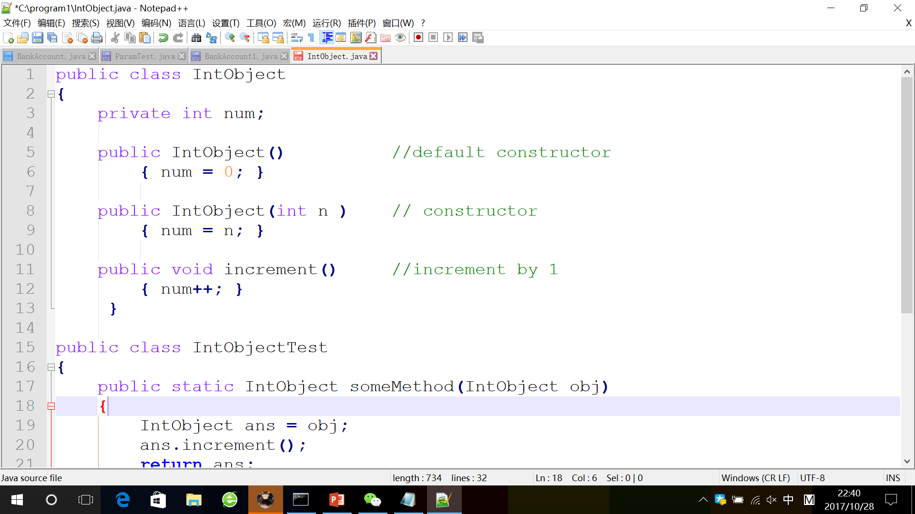
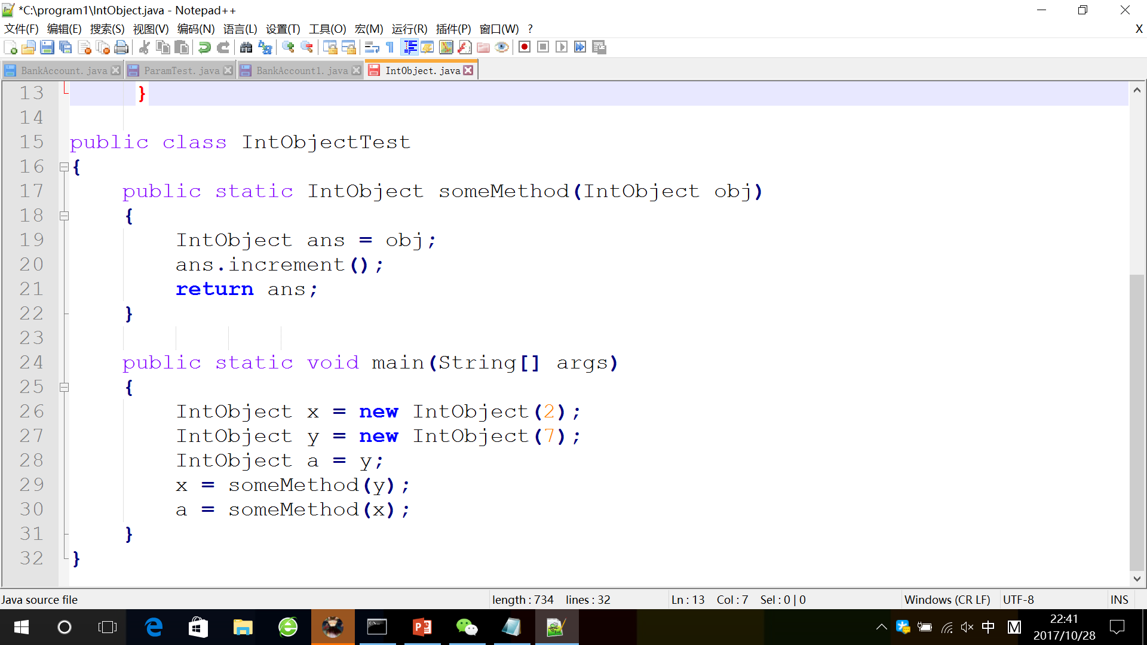
Practice
This question refers to the following the class:
Here is a client program that uses this class:
Just before exiting this program, what are the object values of x,y,and a,respectively?
(A) 9,9,9
(B) 2,9,9
(C) 2,8,9
(D) 3,8,9
(E) 7,8,9

Slide 21
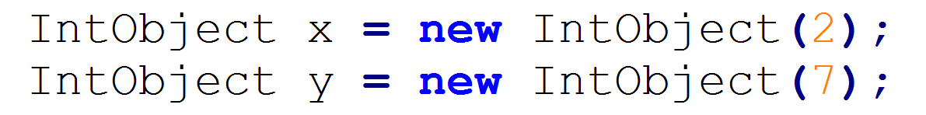
x
y
num:2
num:7

Slide 22
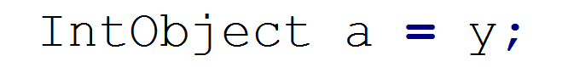
x
y a
num:2
num:7

Slide 23
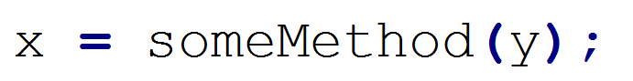
x
ans
y a
num:8
num:2
num:7

Slide 24
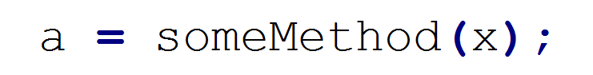
x
ans
y a
num:9
num:8
num:2
num:7

Slide 25
THANKS LRM

